Slide 1

Center for Development of Advanced Computing - Patna
TRAFFIC VIDEO ANALYTICS USING YOLOv7 IN COMPUTER VISION
By
Abhishek Kumar (220980728001.:)
Shivendra Patil (220980728005.:)
Rohit Ingle (220980728006.:)
Guided By
Mr. Sai Krishna

Slide 2
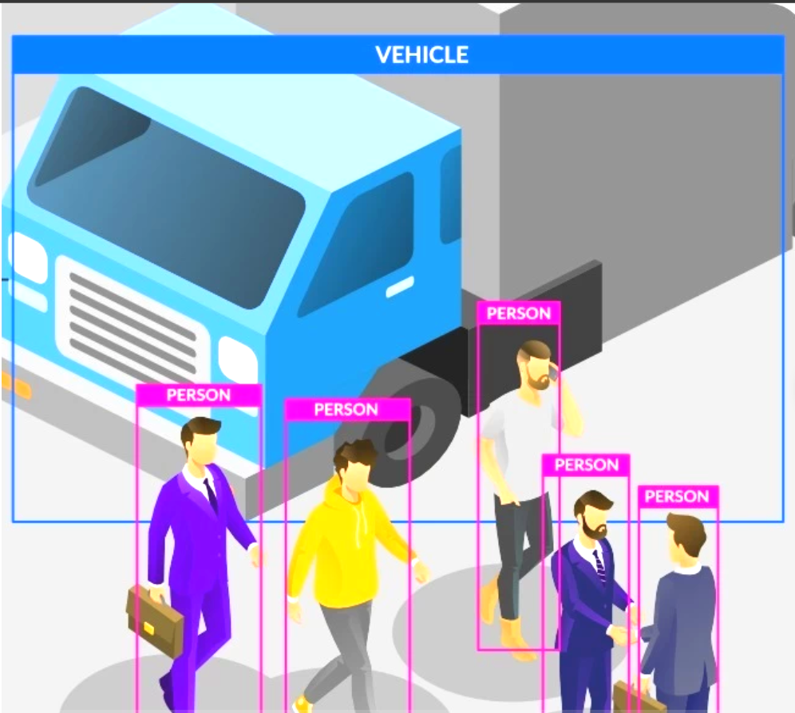
Agenda
Introduction
Problem Statement
Objective
YOLOv7 Algorithm
Methodology
Implementation
Results
Conclusion
Future Scopes
References

Slide 3
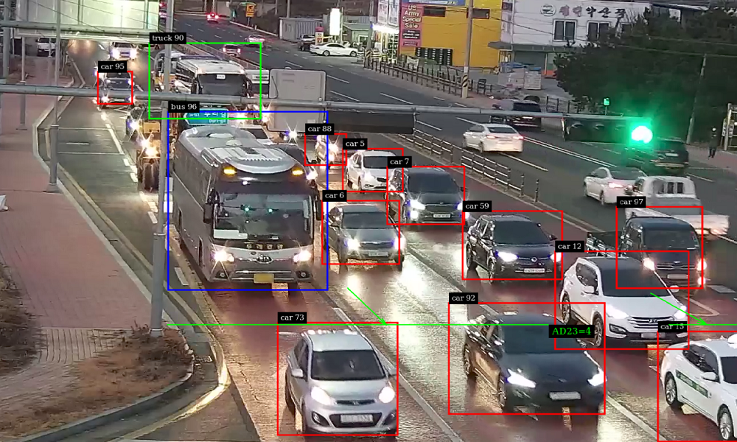
Introduction
Traffic video analytics is an advanced technology that involves the use of video cameras, computer algorithms, and artificial intelligence to monitor and analyze traffic flow.
It has become an essential tool for traffic management and is widely used by traffic authorities, city planners, and transportation engineers to improve traffic safety, reduce congestion, and enhance the overall traffic experience.
Credit @ nvidia.com

Slide 4
Problem Statement
Traffic video analytics can be used to solve several problems related to traffic management and safety.
One such problem is the classification of vehicles and detection of pedestrians in real-time from video footage.
This is a challenging problem due to the variability in the appearance and motion of different types of vehicles and pedestrians.

Slide 5
Objective
The objective is to develop a system for real-time classification of vehicles and detection of pedestrians from traffic video footage.
The system should be able to accurately identify different types of vehicles and detect pedestrians with high accuracy.
The accuracy and efficiency of the system will need to be validated through testing on custom datasets of traffic video footage.
Here we used object detection algorithm YOLO for classification vehicles and pedestrian detection from the footage.
We used YOLOv7 as it works faster, accurately and have more precision average than other object detectors.

Slide 6
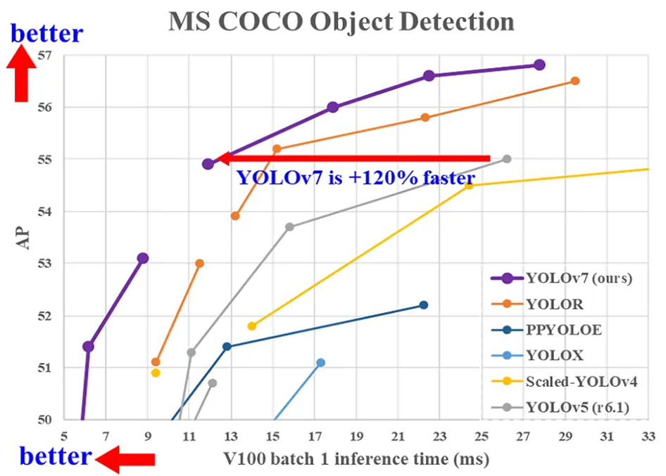
YOLOv7 Algorithm
Object detection Algorithm
Surpass all object detectors in speed and accuracy
Range from 5 - 160 FPS,
Accuracy is 56.8%mAP
Outperform other detectors
Improve detection accuracy without increasing inference cost
Limitations
Requires a large dataset
Limited to detecting only certain objects
Limited to detecting 2D objects only
Computationally expensive
Credit @ WongKinYiu / yolov7

Slide 7
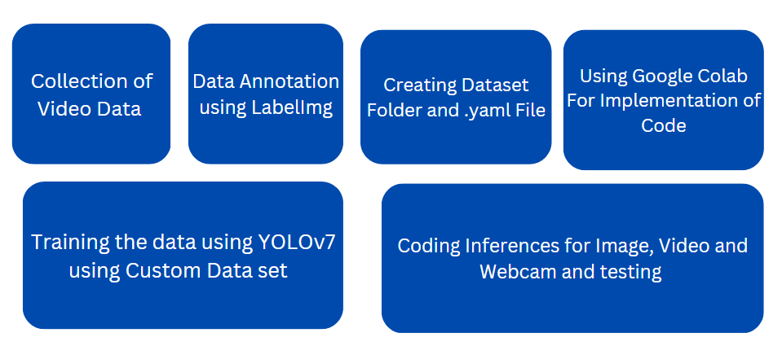
Methodology

Slide 8
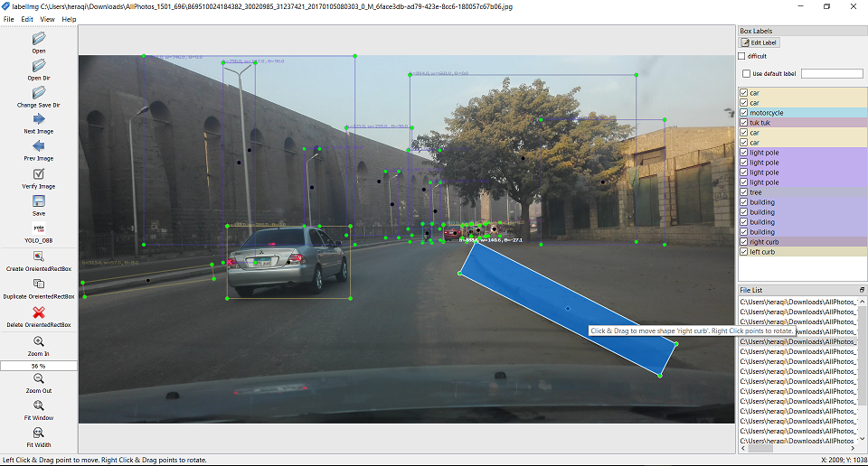
Implementation
. Data Collection:
The first step is to collect traffic video footage that contains a variety of different types of vehicles and pedestrian scenarios.
Data Annotation:
Using ffmpeg command in Anaconda Prompt
ffmpeg -i input.mp4 -vf fps=25 %img.jpg
Using Labelimg.py tool for data annotation
LabelImg is a graphical image annotation tool. It is written in Python.
Creating Dataset folders with images train and validation folders for images and annotation data in .txt format and test data for evaluation. The dataset is splitted in 80% and 20% format.

Slide 9
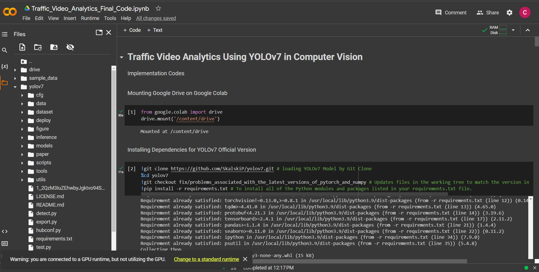
Implementation
We use Google Colab For Implementation
Installing Dependencies for YOLOv7 Official Version
Download Dataset from drive and unzip it in YOLOv7 Folder
Download Weights for YOLOv7 from github yolov7_training.pt
Training the YOLOv7 Model
Running the Evaluation
Inference Code for Custom Dataset
Video Inference
Webcam Inference
Single image Inference

Slide 10
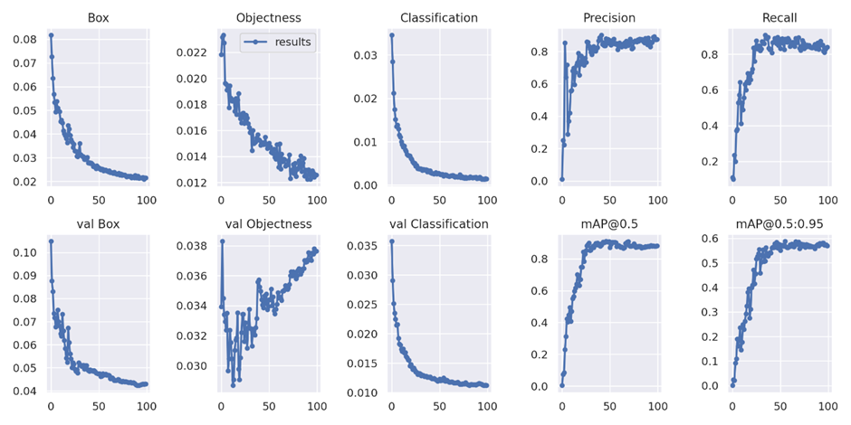
Result
On the Custom dataset, YOLOv7 achieved a mean average precision (mAP) of 95.1% at real-time speeds (25 frames per second), precision at 82.0% , and Recall at 89.12%.

Slide 11
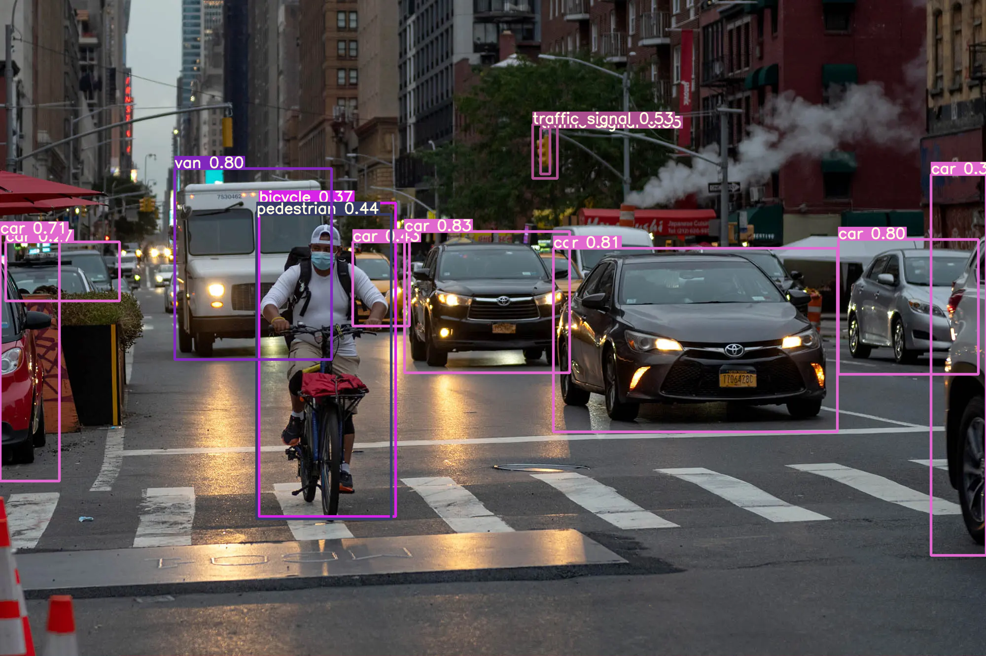
Result
Outcome of Single Image Inferences

Slide 12
Conclusion
In conclusion, the implementation of traffic video analytics using YOLOv7 to classify vehicles and pedestrian detection is a promising technology that has the potential to enhance traffic management and public safety.
The project aims to improve traffic flow by monitoring the movement of vehicles and pedestrians.
By classifying different types of vehicles and pedestrians, the system can identify potential traffic congestion areas and take proactive measures minimize traffic disruptions.
The system is able to accurately detect and classify objects in real-time, which can help authorities make informed decisions about traffic management.
However, like any technology, there is always room for improvement.

Slide 13
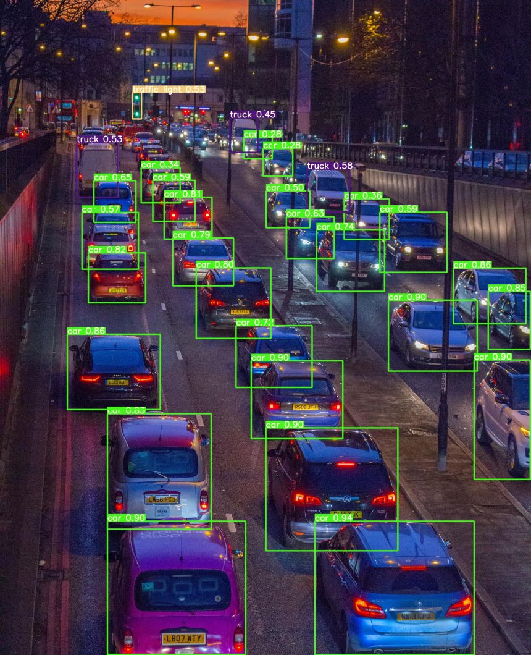
Future Scopes
Integration with Traffic Management Systems
Incorporation of Vehicle Speed Data
Detection of Other Types of Objects
Integration with Smart City Infrastructure
Overall, the future scopes for the traffic video analytics project are numerous, and continued research and development could lead to significant improvements in traffic safety and management.
image credit @ viso.ai

Slide 14
References
https://github.com/WongKinYiu/yolov7
https://github.com/topics/vehicle-detection
https://blog.paperspace.com/yolov7/
https://www.analyticsvidhya.com/blog/2022/08/yolov7-real-time-object-detection-at-its-best/
https://learnopencv.com/yolov7-object-detection-paper-explanation-and-inference/
"Real-time Traffic Surveillance System with Vehicle and Pedestrian Detection using YOLOv7" by Ahmed H. Abdelnasser, Tamer M. Ahmed, and Ahmed A. Abou El-Fetouh.
“YOLOv7: Trainable bag-of-freebies sets new state-of-the-art for real-time object detectors” Chien-Yao Wang, Alexey Bochkovskiy, Hong-Yuan Mark Liao
"Real-time Vehicle and Pedestrian Detection using YOLOv7 on Traffic Surveillance Videos" by Shashank Verma, Anil Kumar Tiwari, and Pankaj Kumar.
"YOLOv7-based Vehicle and Pedestrian Detection in Surveillance Videos" by Jihen Fakhfakh, Ameni Trabelsi, and Mohamed Hammami.
"Real-Time Vehicle Detection and Tracking in Traffic Videos Using YOLOv7 and Deep Learning" by Kai Sun, et al.

Slide 15
Thank You

